Slide 1
Public Restrooms
Piloting the Portland Loo in Philadelphia

Slide 2
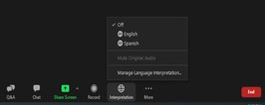
Para Interpretación en Español
Para escuchar esta Junta en Espanol desde una computadora:
Para escuchar esta Junta en Espanol desde un teléfono celular:
Busque el símbolo del globo en el lado derecho de la barra negra en la parte inferior de la pantalla. Puede estar etiquetado como "Interpretación".
Haga clic en el icono del globo terráqueo (deberían aparecer varias opciones de idioma)
Seleccione español.
Silencie el audio original.
Aparecerá un mensaje preguntando si desea interpretación.
Haga clic en el mensaje
Seleccione más
Seleccione “Interpretación”
Seleccione español
Silencie el audio original
Si no apareció un mensaje y está en la reunión busque la opción más en el lado derecho de la barra negra en la parte inferior de la pantalla del telefono. Luego, siga los pasos 3-6

Slide 3
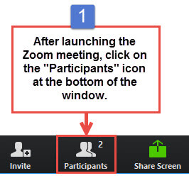
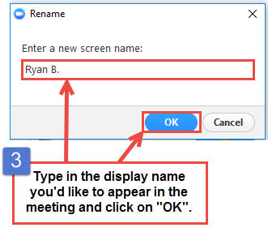
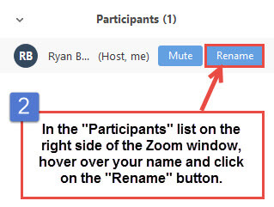
Instructions to change name or add pronouns

Slide 4
Introductions
Icebreaker
Which animal best expresses how you are feeling today?
Name
Pronouns
Title
Organization
1
2
3
4
5
5
6

Slide 5
Agenda
1​ | Introductions
2​ | Overview of permanent restroom pilot
3​ | Community engagement process
4​ | Siting criteria
5​ | Potential locations
6 | Next Steps
Notes:
Frame as we are looking for feedback on all of these items.

Slide 6
Community Engagement Process
Community organization engagement:
Convene broader group of community stakeholders to decide top choice location
Stakeholder engagement:
Civic and CBO leaders share feedback & identify locations
Site visits
Public engagement:
Continuous engagement and education until the installation
Short term solution:
City deploys porta potties in key areas
Public concern about lack of restrooms
City begins looking at long-term solution
311 complaints about restrooms increase
Notes:
Stakeholder Engagement Goals:
Measure buy-in and support from impacted and interested community organizations
Additional site criteria
Identify locations for site feasibility visits
Provide feedback on community engagement process
Community Organization engagement goals
Present the top locations analyzed by the site feasibility group
Select the top locations
Public engagement goals
Education about the Portland Loo and location
Build excitement about this new amenity

Slide 7
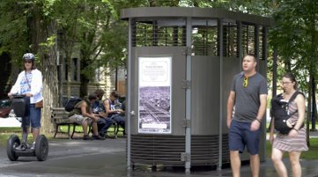
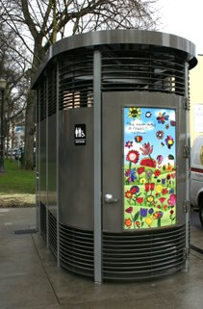
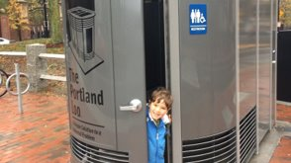
Public restrooms benefit everyone.
Notes:
Supports tourists and the business community
Contributes to age and family friendly communities
Improves quality of life
Advances gender and racial equity
Supports the most vulnerable

Slide 8
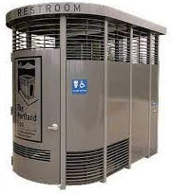
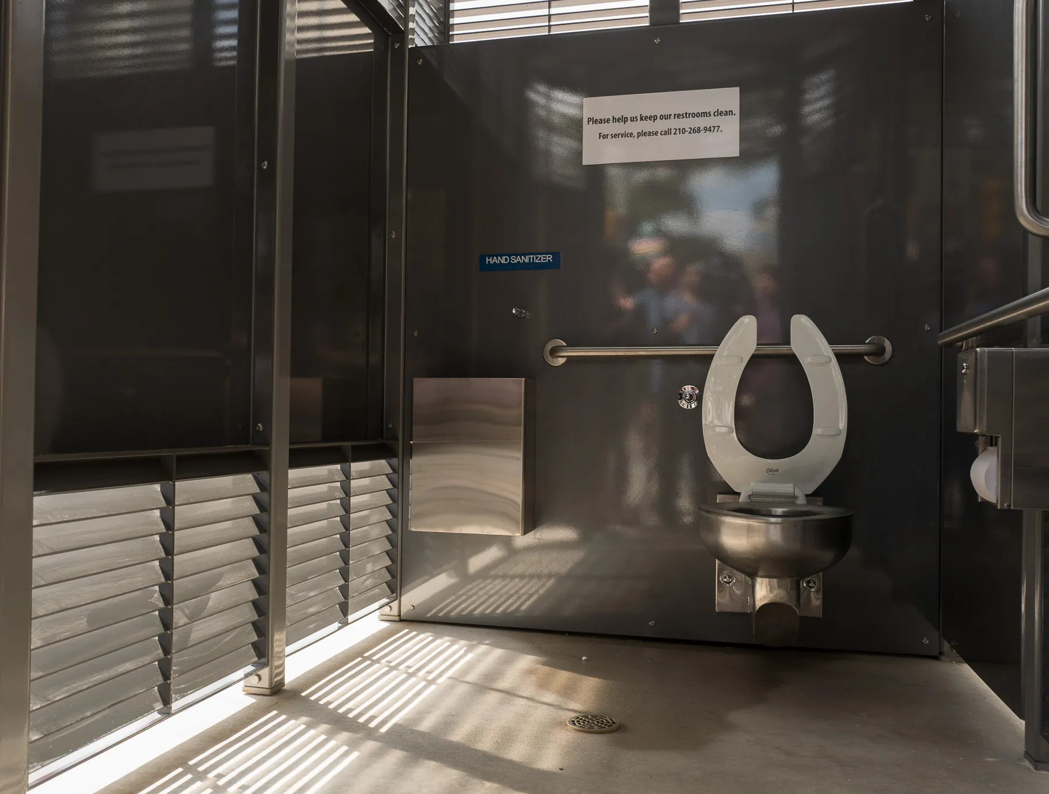
The Portland Loo
A skylight and a motion-sensing LED lighting
Fits a bike, stroller, or two
adults with a child
Grating at the top and bottom
Internal hand washing station
and diaper changing table
Accessible
Notes:
Acknowledge the city's other public restroom models (trailers, staffed porta potties, quality assurance porta potties) and why a permanent model is a better choice.
Why the Portland Loo is the model the City is interested in. (First installed over 10 years ago, the Portland Loo has proven to be a successful model in over 20 Cities. The City spoke with some of those other cities to hear their feedback and recommendations).

Slide 9
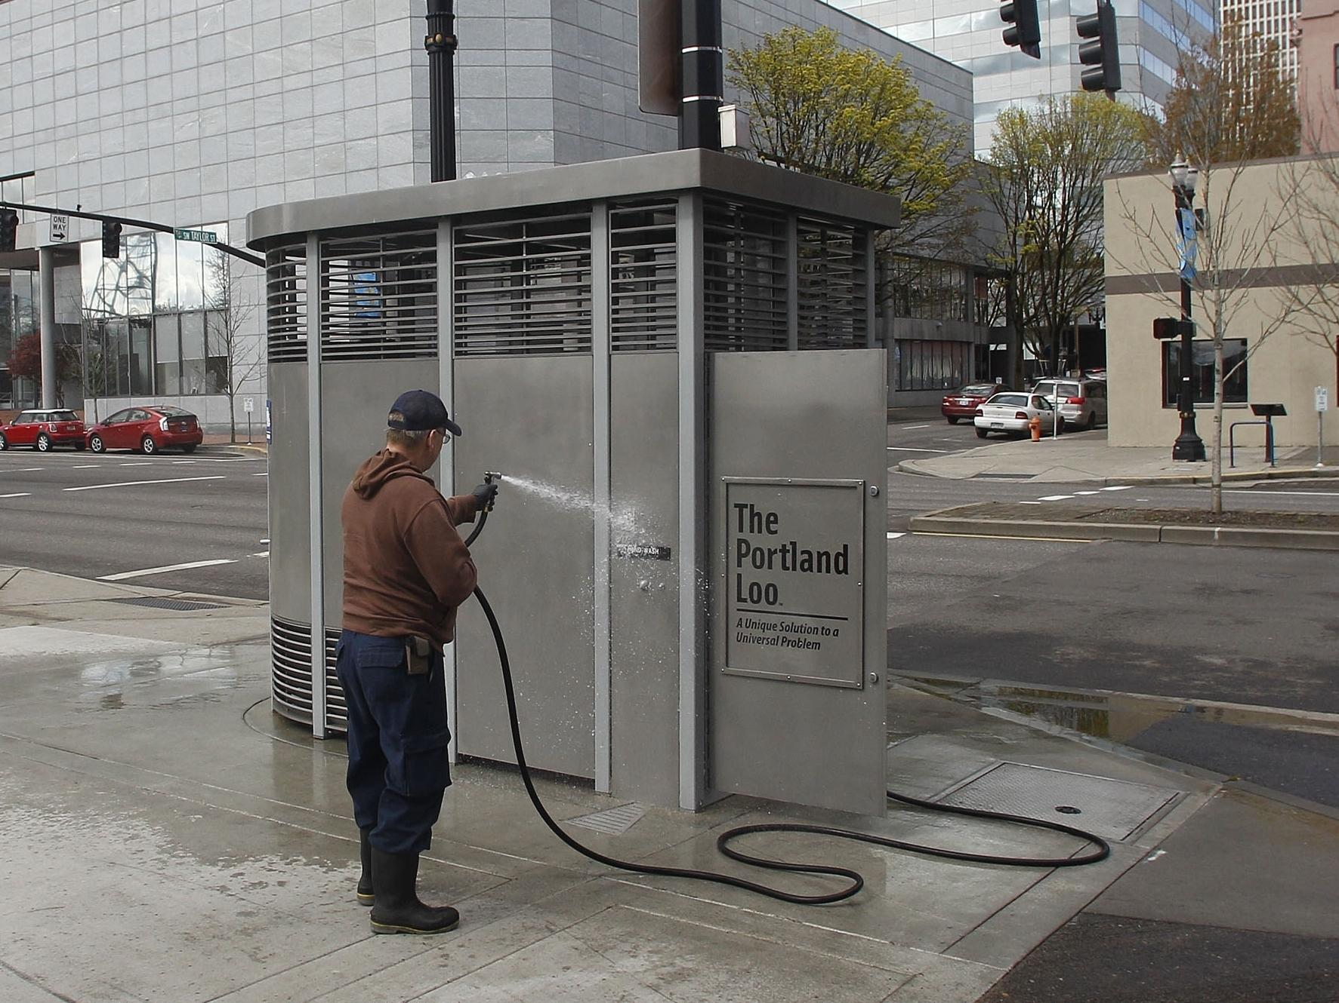
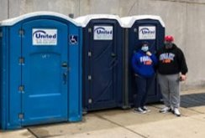
Operations and Maintenance
Porta Potties at MSB
Notes:
PDPH has two full-time staff who currently maintain the porta potties. They would maintain the Loos and surrounding area including responding to neighbor's complaints
Hours of operation are open to community input
Ability to set automatic locks from off site
Graffiti resistance finish and built-in cleaning hose
Heated coil for winterization (addresses a problem that the City had with the trailers)
Stainless steel, replaceable wall panels
Security planning is included in site criteria

Slide 10
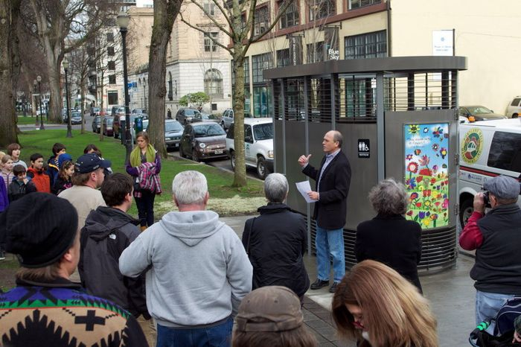
Community engagement ideas
Notes:
Online engagement through social media
Explore partnership with public art community for engagement
Utilize current bathroom staff at MSB
a fun launch event like this one that has school children singing about the Loo

Slide 11
Questions?

Slide 12
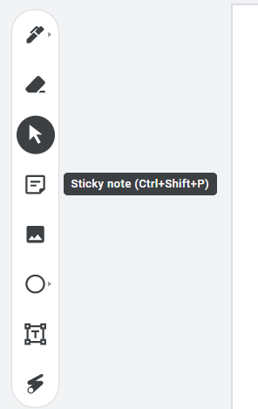
Site Selection Criteria
Link to Jam board:
https://jamboard.google.com/d/1oK4VM_ODD9JqGlV78JldUHzujxh8smhaABhr2ZP8Qfc/edit?usp=sharing
Create your own post-its for criteria you want to add
Option to come off mute or type in chat
Notes:
Explain what a jam board is
We have already populated a jam board with the criteria that the subcommittee came up with.
Some of these technical criteria cannot be changed (size of the loo), but we want input on other items that we should be thinking about.

Slide 13
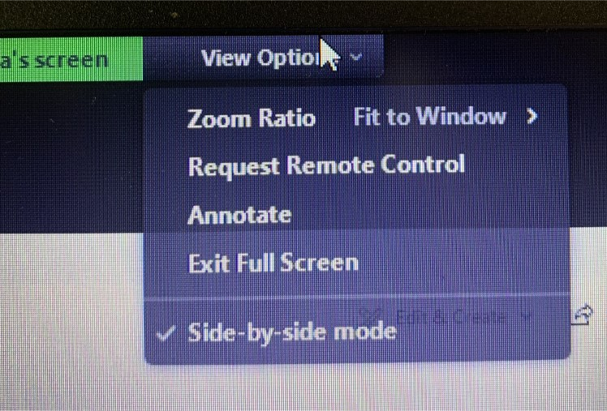
Zoom Instructions for map activity
Click "View Options"
Click "Annotate"
Use up to 3, star stamps
Option to come off mute or type in chat

